Slide 1
Early forest fire detection and prevention using drone.
Presented by:
K.VIJAYALAKSHMI
S.ABIRAMI
S.NIRUPAMA
S.SAMITHRA
Guided By:
Mr. G. ILLAMURUGAN

Slide 2
Abstract:
An integrated and modular approach for early forest fire detection and suppression.
Based on an adequate combination of different detection systems depending on wildfire risk, the size of the area and human presence affiliated with an adequate logistical infrastructure, training by simulation, and innovative extinguishing technology.
Addresses the following issues:
Predict the impact of affected areas and assess the amount of damage
Identify affected people and animals
Prioritize rescue operations
Alert the officials and other emergency needs like ambulance,etc
Provide location of disaster through mapping facilities
Before and after photos
Extinguishing small fires

Slide 3
Introduction:
The proposed system acts as a wildfire prediction and prevention system for forests and other places of ecological importance.
A mini drone is sent to the most accident prone zones and monitors the surroundings via both normal and an infrared cameras.
A very high reliability of fire detection and a concomitant low false alarm rate can be achieved by the combination of an infrared camera, a microwave radiometer and additional sensors of fire sensors.
In case of small fire detection, the drones are built with extinguisher facilities in order to prevent the environment from being damaged in a large scale waiting for the officials.

Slide 4
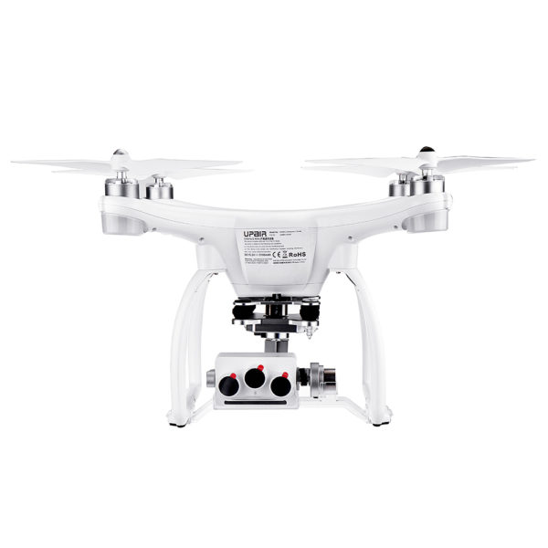
DRONE

Slide 5
Fire detection with gas sensors and smoke detectors
The sensor system is used to verify an ambiguous situation detected by a video-based system as well as to extinguished fire.
Therefore, sensors have to be widely immune against disturbances like steam, fog, dust pollution and condensing water which usually cause video-based systems to give false alarms.
If fire gases are carried to the detector by the airflow they are analyzed with different semiconductor gas sensors.
A gas permeable protective cap made of sintered metal protects the sensor elements against soiling with dust and humidity. Thus the sensor array is not affected by nuisance aerosols like dust, dirt, mist or condensing water.
High sensitivity is needed to detect even low smoke concentration; dilution and extreme turbulence caused by wind are essential factors.
Main features of this semiconductor gas sensor (GTE GSME) are a very fast response time and a high sensitivity .
A CXHX-Sensor [0 – 5ppm] is used because hydrocarbon sensors are sensitive to organic fire products.
Fast temperature fluctuations are measured by a temperature sensor.
Additionally a highly sensitive aspirating system is used for smoke detection in case of observing an extinguished fire with a blimp.

Slide 6
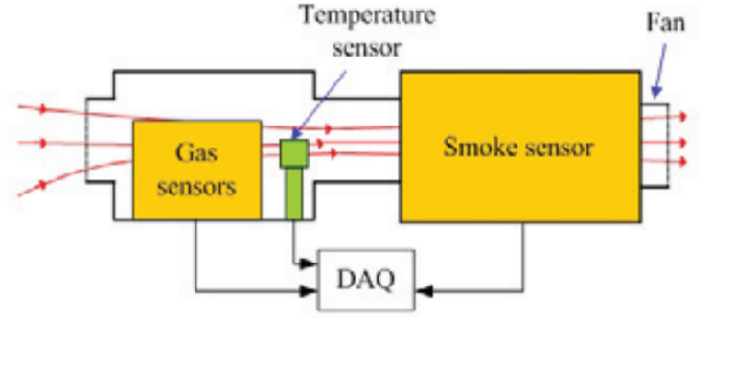
Structure of sensor system

Slide 7
Input unit
The IR camera and the fire sensors work together to detect possibilities of wildfire in the area covered by the drone.
When the sensors sense fire the camera captures images and sends an alarm to the officials in charge with the help of gsm module.
The gps system also allows the officials to track down the exact location of the wildfire.
Processing unit

Slide 8
Enrollment Module:
In this enrollment module, the data which collected from input camera and sensors are stored in the database.
image
Sensor detains
DATABASE

Slide 9
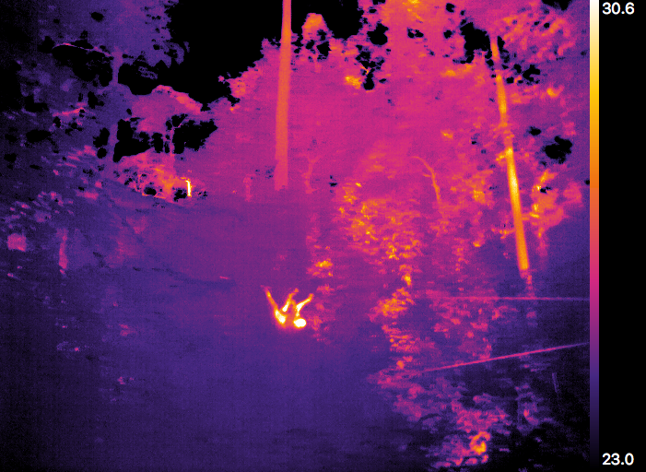
IR identification of affected people and animals

Slide 10
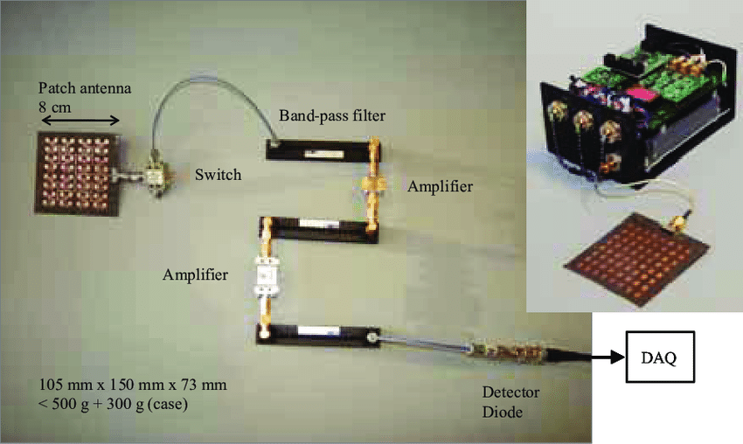
Microwave radiometer
The proposed microwave radiometer detects fire radiation at 22.3 GHz.

Slide 11
System Implementation:
There are two parts in this section. The first is the implementation of the drone with its camera and sensors and the second is the implementation of fire alerting system.
For sending alert to the authority we are using GSM module.
The GPS system in the drone enables officials to track the location of the wildfire.

Slide 12
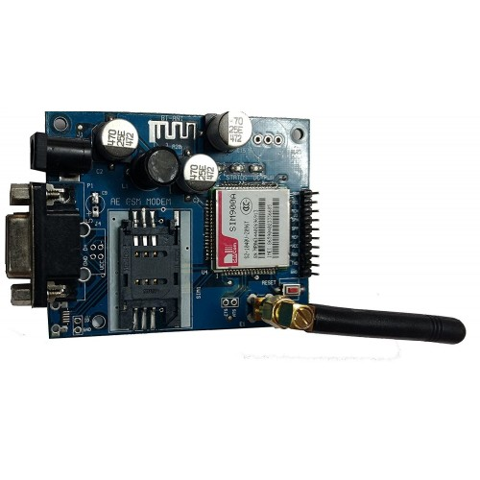
GSM Module:
GSM module is used to send a message to the forest officers to indicate that fire as been occurred in the respective place. This works with Arduino .Here we use sim900A GSM module.

Slide 13
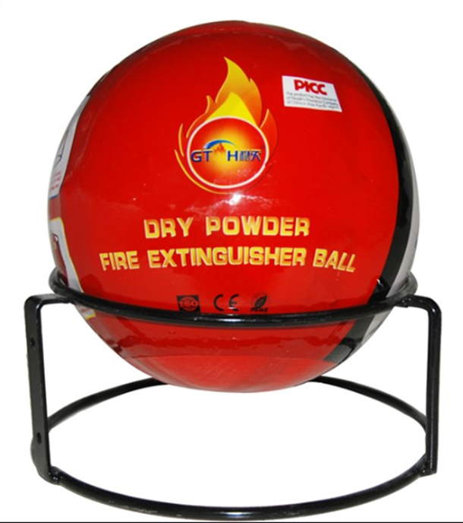
Fire extinguisher ball
In times of early detection of fire we planned to drop an fire extinguisher ball from the drone which is made with dry powder.
The drone will drop the ball as soon as the sensors have detected the fire and considered it to be in initial stages.

Slide 14

Overview of the model:
start
Fire is detected
Images, sensor information and location are sent to the officials
Wild fire in initial stage
yes
Extinguishes fire
no
end

Slide 15
Technologies Used:
IOT
GSM module
GPS for locating and mapping
Fire sensors
Drone
Aurdino
Microwave radiometer
Infrared imaging

Slide 16
Cost Estimation:
Components: Cost:
1.Drone 50,000
2.Gas sensor 1,000
3.Distance sensor 1,000
4.GSM module 2,000
5.Aurdino 1,000
6.IR camera 5,000
7.Breadboard 1,000
8.Microwave Radiometer 1,500
9.Dry powder 5,000
Total=67,500
* these cost estimation are made purely based on our views and current market price of the components and it may vary.

Slide 17
Future Advancements:
Our model will have some problems during the message transmission due to signal problem in some conditions and places.
In that case our future work will be like in case of any wildfires report will be sent to emergency numbers that functions without any signal.
Highly secure drone structure can be deployed to ensure there is no damage due weather or climatic conditions.

Slide 18
THANKING YOU!!

Slide 19
ANY QUERIES ?

